Slide 1

Online Classes Registration Software Project
Danny Escalante
University of Arizona Global Campus
CST-499: Capstone for Computer Software Technology
Instructor: Joseph Rangitsch

Slide 2
SRS – Online Class Registration
successful implementation of a dependable, secure, and user-friendly software solution
aims to delineate the testing strategy, scope, resources, and timeline for the online class registration software
regular status updates are provided until incidents are resolved,

Slide 3
MAIN UML CLASS DIAGRAMS

Slide 4
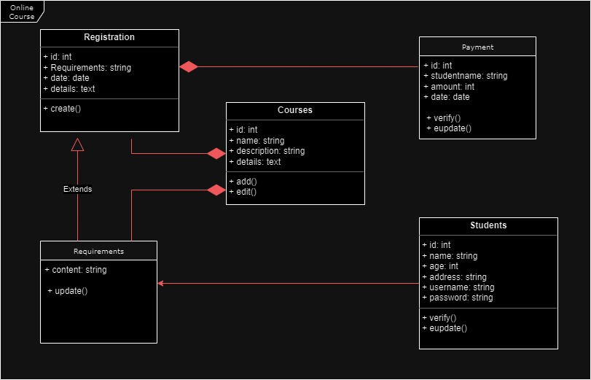
CLASS DIAGRAMS
Providing class structures, relationships, and inheritance hierarchies clearly and concisely using a combination of interactive tutorials, instructional films, and hands-on exercises

Slide 5
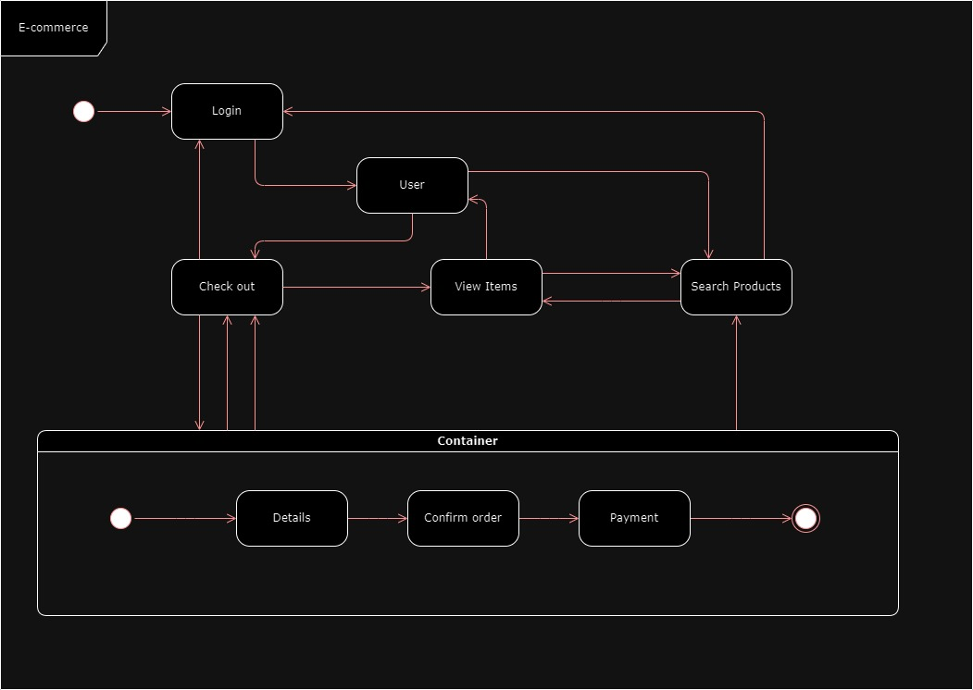
STATE DIAGRAMS
notation and symbols, along with methods for handling concurrent states and capturing complex behaviors

Slide 6
ONLINE CLASSES PAGE DESIGN

Slide 7
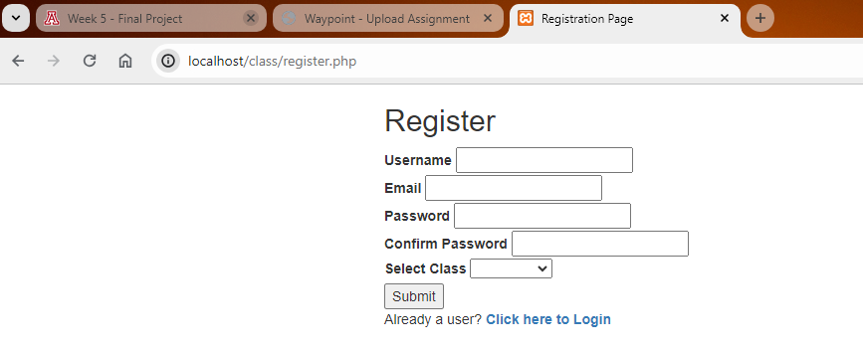
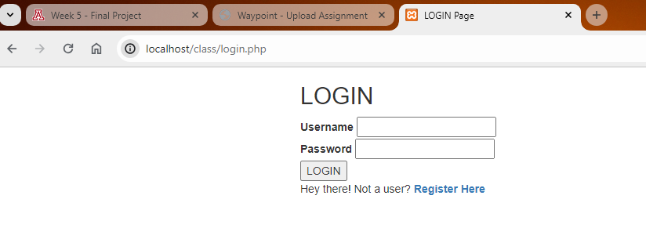
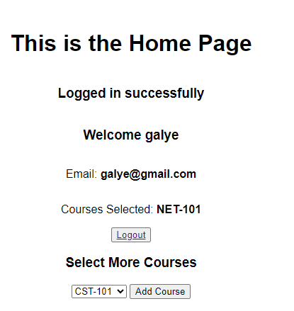
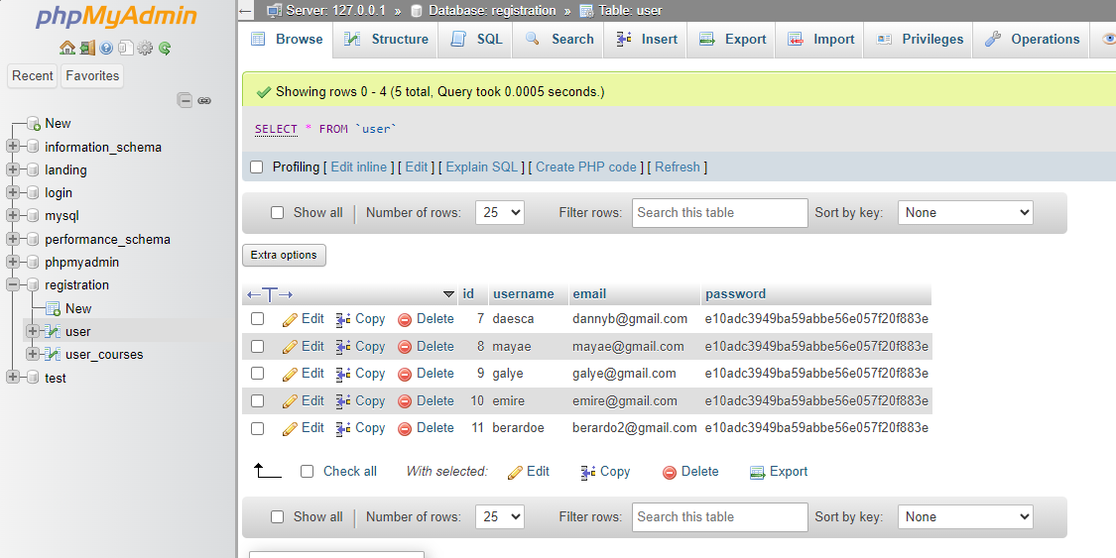
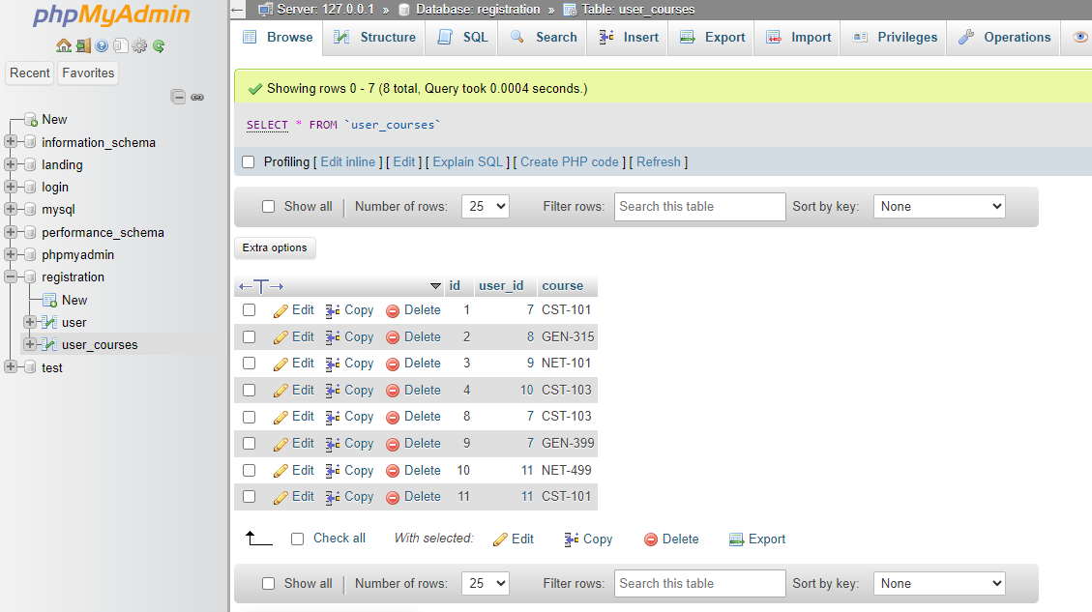

Slide 8
PHP CODE

Slide 9
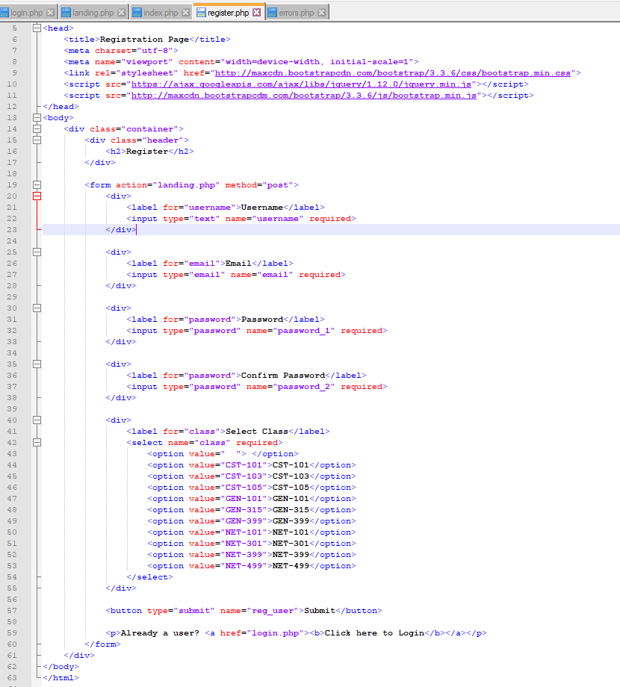
username, email address, password, SELECT CLASS can be entered AND THEN WILL DISPLAY ALL DATA ENTERED, ALSO THIS GUARANTEE A secure login functionality

Slide 10
THANKS.

